Slide 1

New Movies
This application show description about new movies

Slide 2
Description
This app use TMDP API https://www.themoviedb.org/documentation/api
We will get a response from the server in a Json format and use a website to convert it to java class http://www.jsonschema2pojo.org/
After converting the file we will use libraries like Retrofit2 , OkkHttpClient and Gson libraries to be able to deal with the data.
We also use CircleImageView to show the actors of the movie.
We also use Glide library to load the image into the ImageView Using The URL of the image.

Slide 3
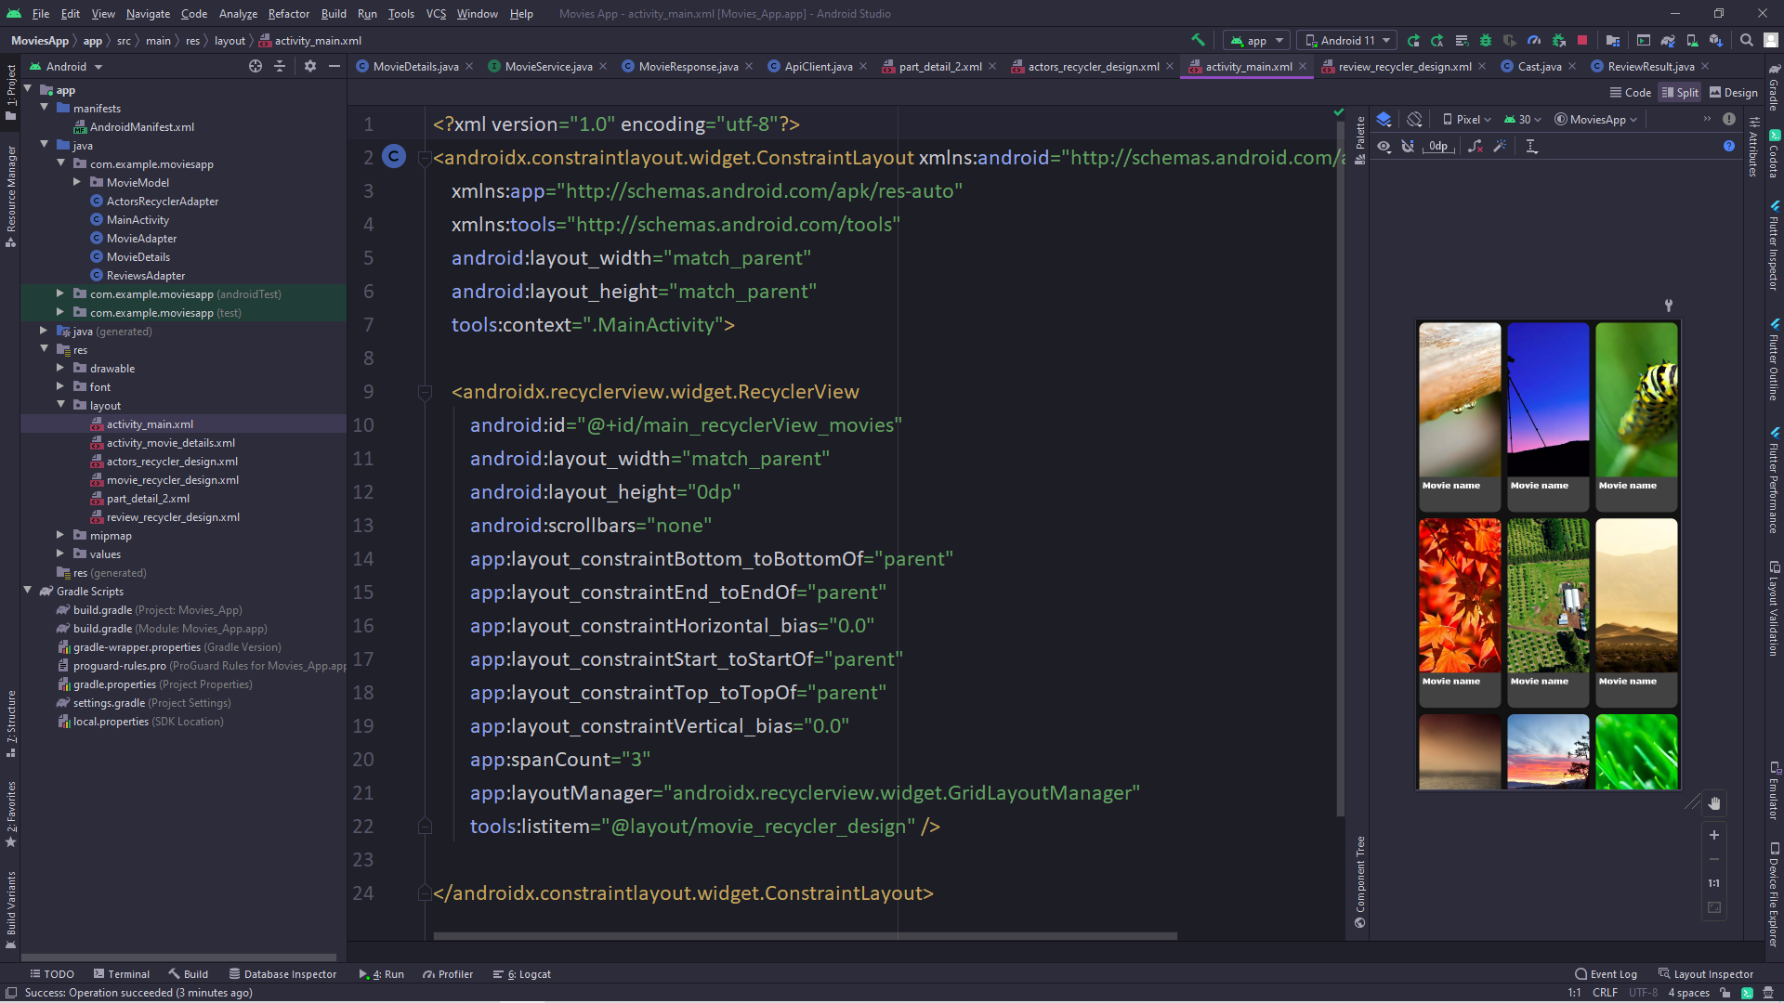
MainActivity
We will use RecyclerView to show the data on it, so the xml file for the design will be like that :

Slide 4
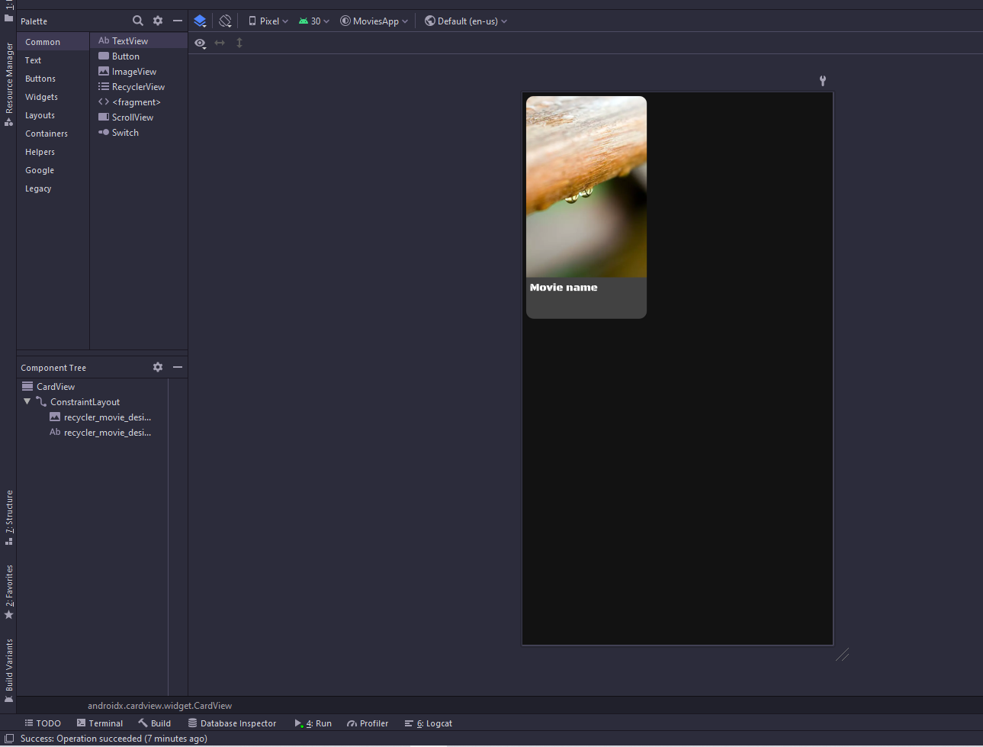
Movie Recycler Design
We will build the recycler to only show the movie name and the poster image ,so the XML file for the design will be:

Slide 5
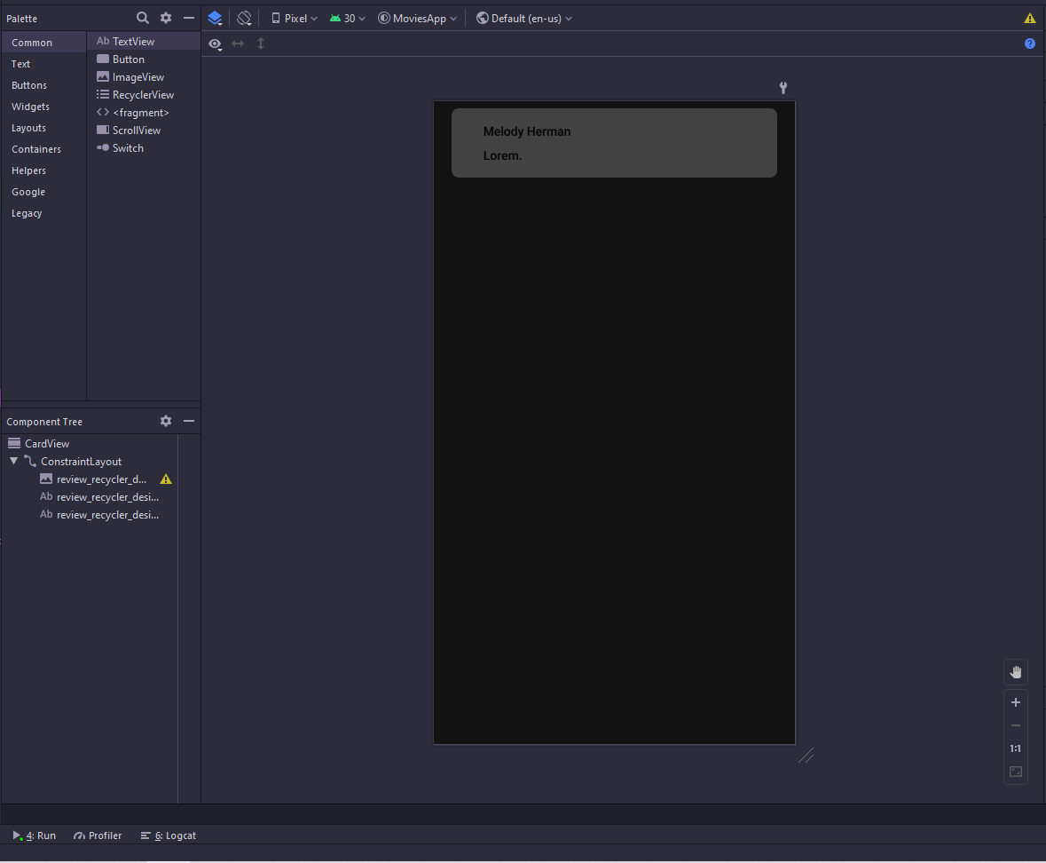
Reviews Recycler Design
People wrote review after they see the movie ,so we will show all reviews using a Recycler view on Detail activity
The XML Design will be like that :

Slide 6
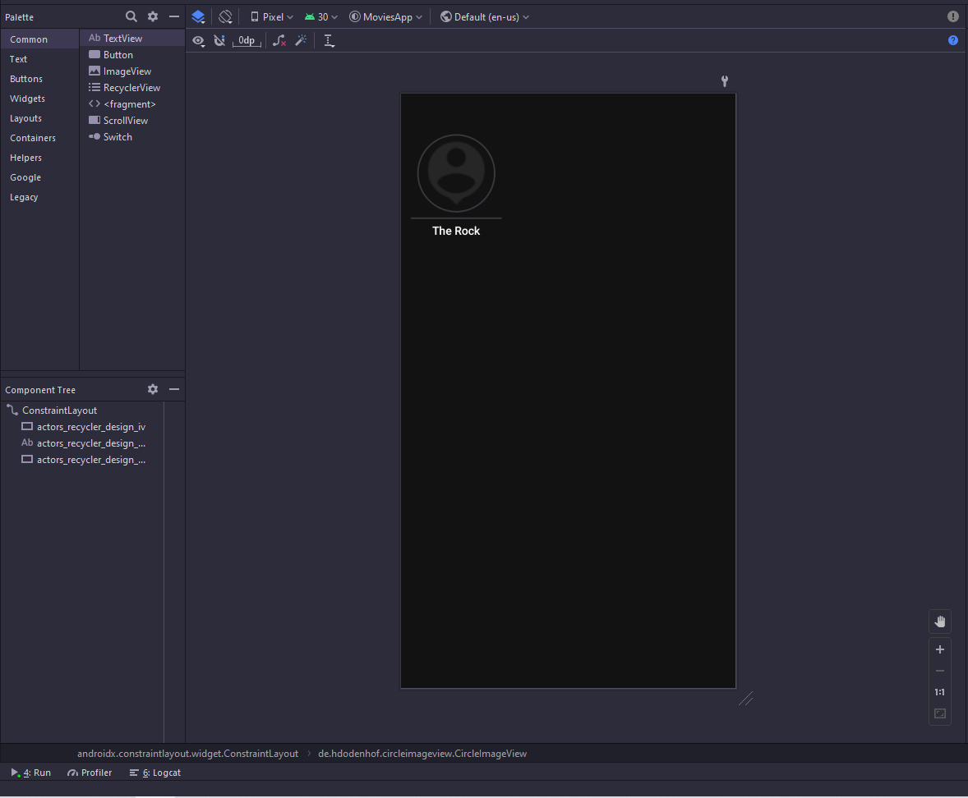
Actors Recycler Design
We will use Recycler to show
the Actors in this movie ,
this recycler will be on the
Detail Activity that will describe
the movie.
The XML Design will be :

Slide 7
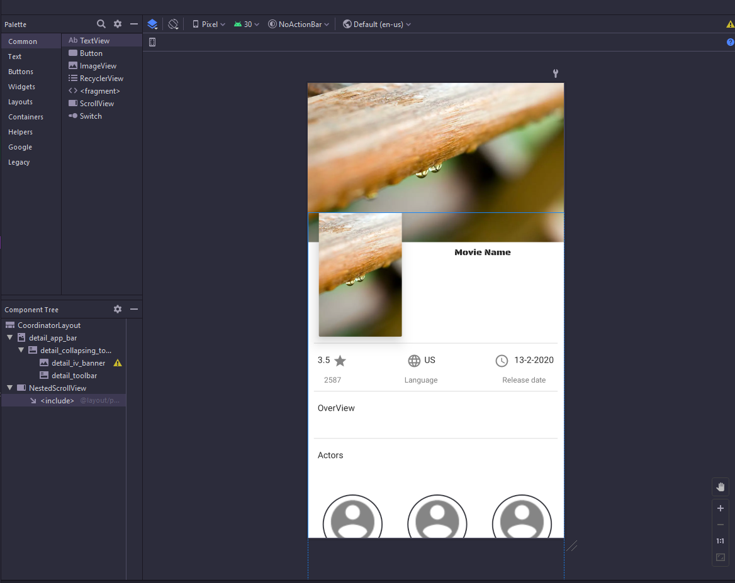
Detail Activity
This activity will show
all things about the movie
like his title , rating , comments,
actors , reviews , poster image ,
background image , ...
The XML will be :

Slide 8
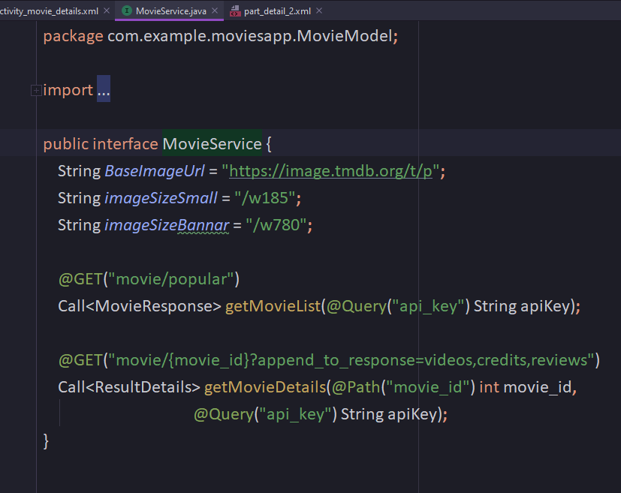
Get The Data From The Server
To get the data we will use a lot of classes at first we will make interface to get the data
We also Make it return
The data into MovieResponse
Class ‘this class is created
Using Json2Pojo website’
This class contain all the data
Returned from the server.

Slide 9
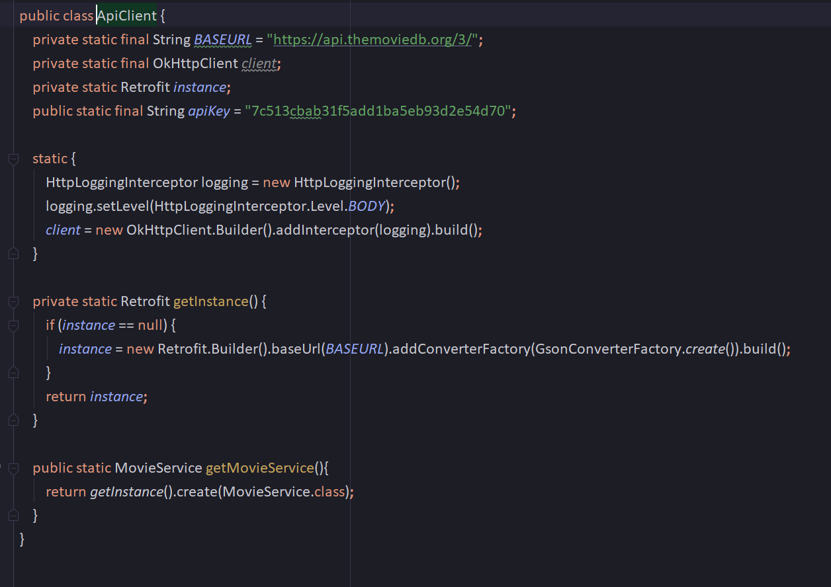
Then we will build API Client Using Retrofit and OkHttpClient

Slide 10
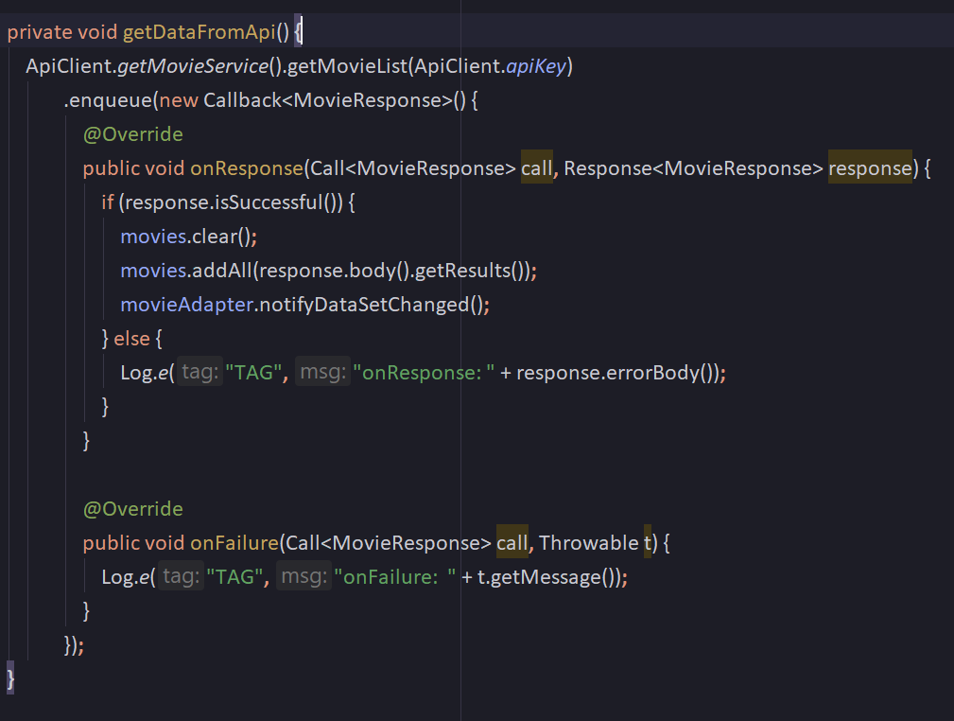
Main Activity ‘Java Code’
The most important code in the main activity is the code that we call the server to get the data.
This code will be like that :
That will return the data
Into MovieResponse.class
And the body contain all the
Data returned from the server.

Slide 11
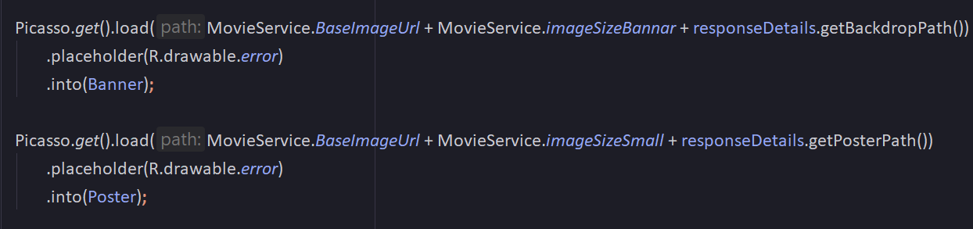
Using picasso To Load the Image From URL
To Load the Image Using URL we use two ways :
The first way is to use Picasso
The second way is to use Glide
In this app we use Picasso like that →

Slide 12
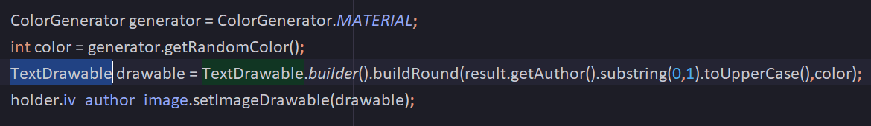
Using Colored Text To Be Image
We use recycler view to show all reviews about the movie , so we need to but the first character of the person who write the comment and put it into the image
To do that we use TextDrawable class like that →

Slide 13
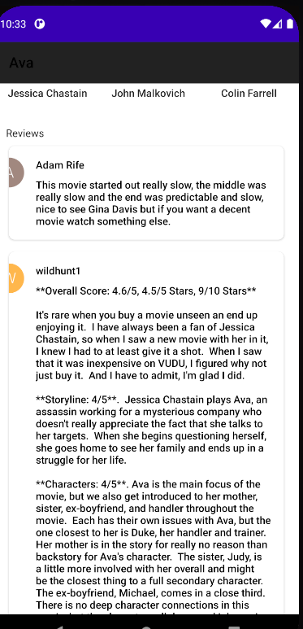
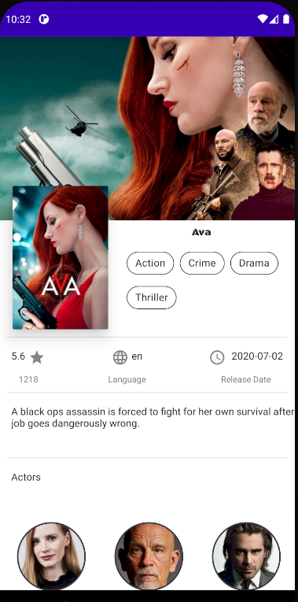
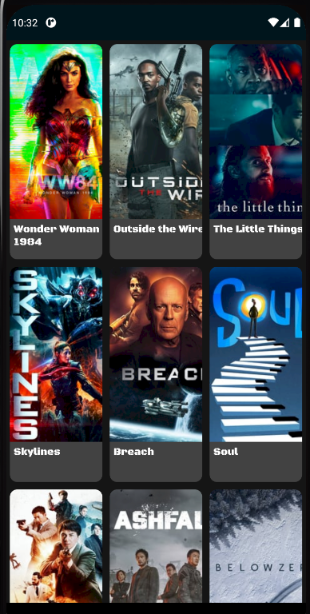
These images from the application :

Slide 14
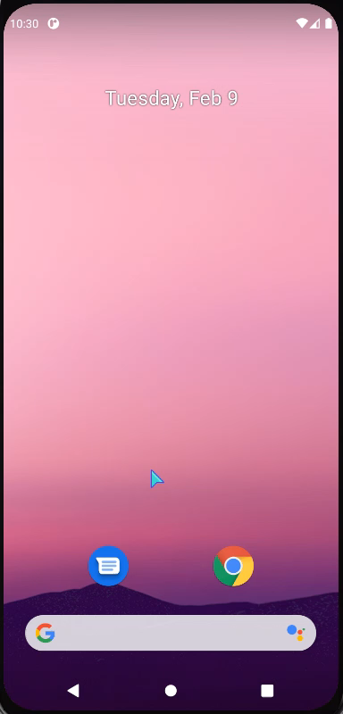
That is a short
Movie describe
The application

